Slide 1

Infrastructure as a Service and Microsoft Azure Stack Hub
Storage in Microsoft Azure Stack Hub
This work is licensed under a Creative Commons Attribution - ShareAlike 4.0 International Public License

Slide 2
Agenda
Azure Stack Hub Storage Overview
Storage Services in Azure Stack Hub
Storage Types
VM Disks, Blobs, Tables, Queues
Storage Usage
Storage Management

Slide 3
Azure Stack Hub Storage Overview

Slide 4
Storage services for Azure Stack Hub
IaaS
PaaS
Custom apps
Web and mobile
Microservices
Virtual machines
Storage
Networking
Disks
Persistent disks for Azure IaaS VMs
Files
Objects
Highly scalable, REST object store
Block Blobs: Sequential file I/O
Page Blobs: Random-write pattern data
Append Blobs
Tables
Scale-out NoSQL store
Fast key/value lookups
Queues
Reliable queues at scale for cloud services
Decouple and scale components
Message visibility timeout and update message
Storage accounts
Azure Stack Hub Infrastructure

Slide 5




Introduction: Tenant view
Applications
PowerShell, CLI, VS
Storage client libraries (.NET, node.js, python, etc)
ARM
ARM REST API
Blobs REST API
Tables REST API
Queues REST API
SRP Rest API
Storage Services
Storage Account
Storage Account
Storage Account
Storage Account

Slide 6


Introduction: Admin view
Applications
PowerShell, CLI, VS, Storage explorer
Azure Stack Hub PS
Storage client libraries (.NET, node.js, python, etc)
ARM libraries
ARM libraries
ARM REST API
ARM REST API
Blobs REST API
Tables REST API
Queues REST API
SRP Tenant API
SRP Admin API
Storage Services Role
Virtual and Physical Compute Resources
Management
Services
Storage Infrastructure
(Storage Spaces Direct (S2D) with Windows Server Failover Clustering)
Storage Volume
Storage Volume
Storage Volume
Storage Volume

Slide 7
Storage Types

Slide 8
VM Disks
Notes:
NOTICE:
Hide the page 8 (VM Disk) to page 16 (Storage gaps) for unmanaged disk.
Managed disk is recommended.

Slide 9
Disks
Azure
Azure Stack Hub
Host
Host
VM
VM
Driver
Driver
Application &
Tools
Applications & Tools
Driver
Driver
Page Blob REST API
SMB
Page Blob REST API
VHD File
Page Blob
(VHD format)
Blob Service
Page Blob Metadata

Slide 10
Disk operations
Host
VM
VM operations
VM attaches disks
Page Blob is leased by VM
VM read/write to disk
IOPS, latency & throughput
REST API operations
Uploading disk & images
Taking snapshots
Copy snapshots, disks & images
No “Live” snapshots
No “Incremental” snapshots
Driver
Application &
Tools
Driver
SMB
Page Blob REST API
VHD File
Blob Service
Page Blob Metadata

Slide 11
VM Unmanaged Disks – Tenant View
Subscription
Subscription
Resource Group
Resource Group
VM
VM
VM
VM
Scale Set
VM
VM
VM
VM
VM
VM
Storage Account
Container
Container
Subscription
VM
VM

Slide 12
VM Unmanaged Disks – Admin View
Page Blob
Account 1
Account 2
Account 3
1
2
3
1
2
3
1
2
3
Container
Storage Services
VHD File
Storage Infrastructure
Volume 1
Volume 2
Volume N
1
2
3
1
3
1
2
2
3
Directory
…

Slide 13
VM Unmanaged Disks – Admin View
Containers
Users decide in which containers blobs are placed.
The Storage service selects the volume with most available space for new containers.
Disks
VMs can also have one or more data disks.
OS and Data disks are stored as page blobs.
Place each disk into a separate container.

Slide 14

VM I/O sharing
VHD File
Storage Infrastructure
Volume 1
Volume 2
Volume N
1
2
3
1
3
1
2
2
3
Directory
…

Slide 15



VM disk from a marketplace image
1
Create a new VM (from catalog image K) into new Blob B1
Microsoft Azure Stack Hub Portal
Tenant
7
Azure Resource Manager
Tenant VM created
3
SRP “Puts” new Blob B1
2
CRP asks SRP for access path of B1
Azure-consistent Blob Service
Storage Resource Provider
Compute Resource Provider
Blob Store
4
CRP asks SRP to copy from K to path(B1)
New Blob B1
Catalog image K
5
CRP configures Hyper-V host for VHD access @ path (B1)
SRP’s copy orchestration
File Share
PIR File Share
Hyper-V Host
6
Hyper-V VHD access over SMB

Slide 16
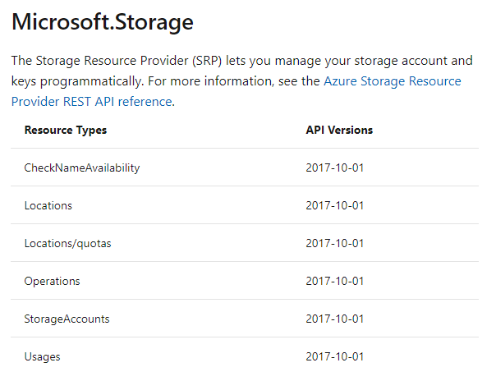
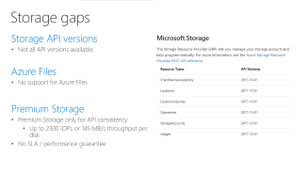

Storage gaps
Storage API versions
Not all API versions available
Azure Files
No support for Azure Files
Premium Storage
Premium Storage only for API consistency
Up to 2300 IOPs or 145 MB/s throughput per disk
No SLA / performance guarantee

Slide 17
Managed Disks

Slide 18
Why managed disks?
Managed Disks
Easier Manageability of blobs
Disk-level RBAC, locks and tags
Snapshots
Automatic even placement of disks in shares

Slide 19


Managed Disks
Managed by Azure Stack
Introduced in Azure Stack 1808
OS Disk
Data Disk
VHDs
Managed Storage Accounts
Simple – Abstracts storage accounts from customers
Manageable – Optimize placement mechanism
Top level resource – Managed disks, snapshots, images as first-class ARM resource
Granular access control – Secure through Azure RBAC

Slide 20
Current state in Azure Stack Hub
Current State
Managed Disk support since 1808
No migration path for existing disks, yet
Maximum 1,023 GiB disk size (compared to 32,767 GiB in Azure)
Managed Disk encryption only using BitLocker
IOPs of premium data disks up to 2300 IOPs per disk
Azure Stack Hub Managed Disks: Differences and considerations https://docs.microsoft.com/en-us/azure/azure-stack/user/azure-stack-managed-disk-considerations

Slide 21
Managed Disks in Azure Stack Hub
Azure
Azure Stack Hub
Host
Host
VM
VM
Application &
Tools
Driver
Application &
Tools
Driver
Driver
ARM REST API
Driver
ARM REST API
Page Blob REST API
Disk Service
SMB
Disk Service
Page Blob
VHD File
On AzS Volume
Page Blob REST API
Page Blob Metadata

Slide 22
Azure Stack Hub Disks Operations
Host
VM
VM operations
VM attaches disks
VM read/write to disk
IOPS, latency & throughput
REST API operations
Disk Create/Update/Delete
Take snapshots
Export snapshots, disks
Driver
Application &
Tools
Driver
ARM REST API
SMB
Disk Service
VHD File
On AzS Volume
Blob Service
Page Blob Metadata

Slide 23
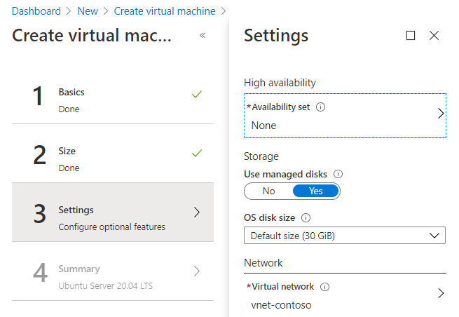
Managed disks
Managed Disks are the default option during VM provision
Can create Managed Disks from VHD files and then attach to VM

Slide 24
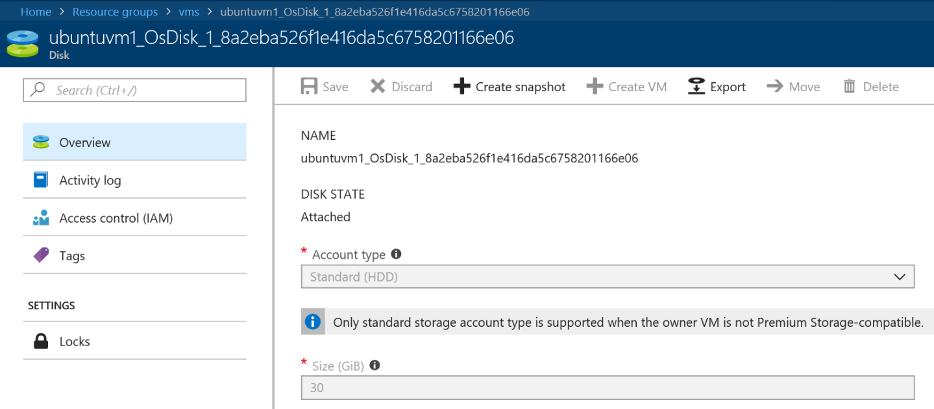
Managed disks
Multiple creation source
Disk-level RBAC, Tags and Logs
Snapshots
Export based on SAS URI

Slide 25
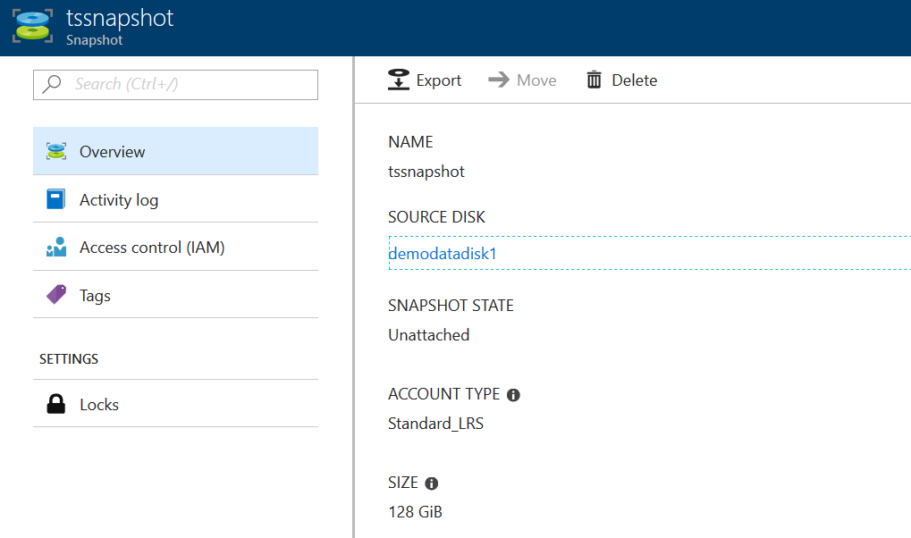
Snapshots
Independent lifecycle
Snapshot-level RBAC
Export based on SAS URI

Slide 26
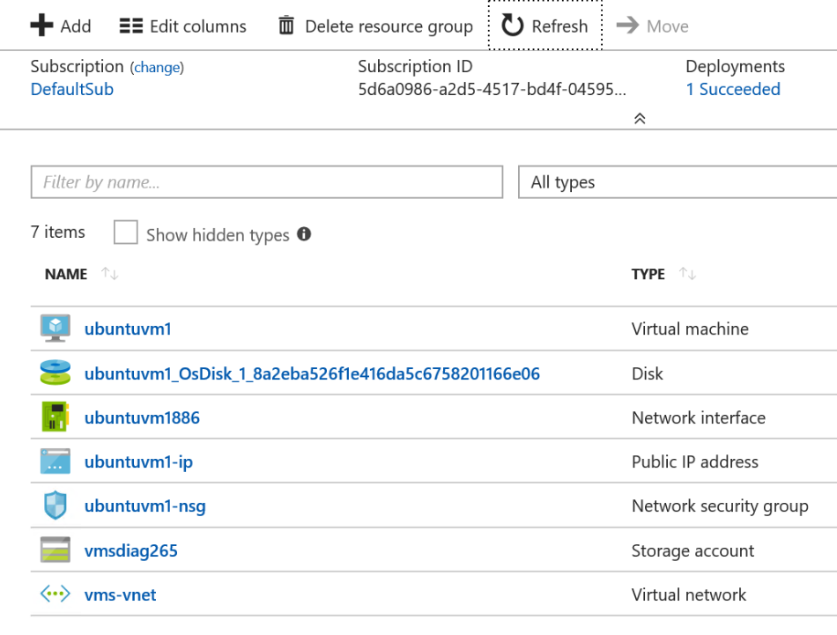
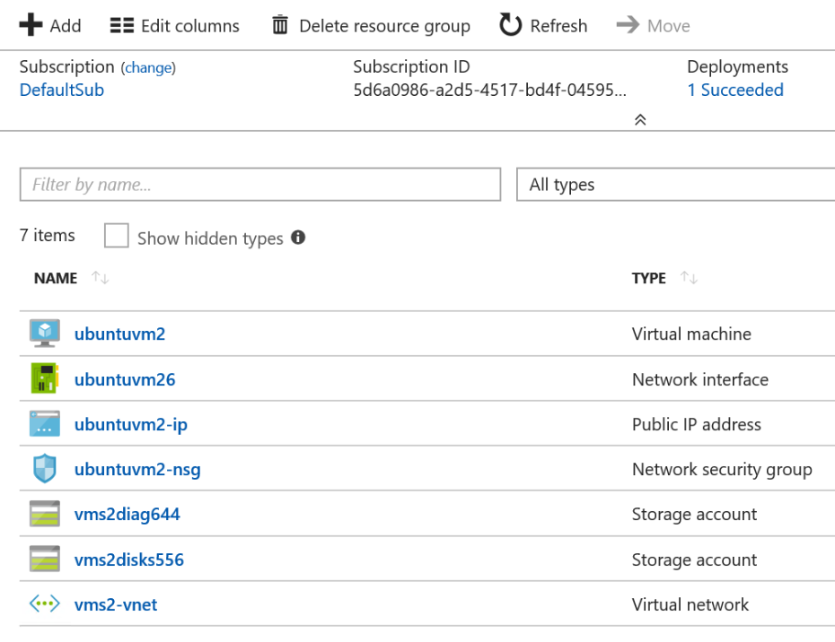
Managed vs. Unmanaged Disks
Managed Disks
One Resource per Disk
no Storage Account needed
Unmanaged Disks
One or more Disks per Storage Account
One or more Storage Accounts
Notes:
Hide the page, managed disk is recommended.

Slide 27
Blobs

Slide 28
What is the blob storage service?
Object Storage: Store and serve unstructured data
App and web scale data
Big Data from IoT, Genomics, etc.
Backups and archive
Key Features
Scalable
Durable – LRS (GRS and ZRS not available)
Highly available
Strongly consistent
Dynamically scale up on bandwidth and TPS
Cost effective

Slide 29
Uploading block blobs
Azure Storage
Image.jpg
(<64 MB)
Image.jpg
(<256 MB)
REST Calls
PutBlob(Image.jpg)
Single REST call up to 256 MB*
New PutBlob will replace existing blob
*256 MB for API version 2016-05-31 and later, and 64 MB for older versions

Slide 30
Uploading large block blobs
Azure Storage
Movie.mp4 (1 GB)
Movie.mp4
Movie.mp4
BL001
BL002
BL003
BLN00
Up to 100MB* per block, variable size
Up to 50,000 blocks
BlockId – constant length per block
Benefits:
Efficient continuation and retry
Parallel, out of order uploads
* less than or equal to 100 MB in size for API version 2016-05-31 and later (4 MB for older versions)
REST Calls
blobName = “Movie.mp4”;
PutBlock(blobName, BL001, BL001Data);
PutBlock(blobName, BL002, BL002Data);
…………
PutBlock(blobName, BLN00, BLN00Data);
PutBlockList(blobName,
BL001,…,BL00N);

Slide 31
Modifying block blobs
Committed
Uncommitted
Committed
BL001
BL002
BL003
BL004
BL005
BL006
BL003
BL004
BL002
BL004
BL002
BL001
BL004
BL006
BL001
REST Calls
PutBlock(BL006);
PutBlock(BL003);
PutBlock(BL004);
PutBlock(BL002);
PutBlock(BL004);
PutBlockList(
u=BL002,c=BL001,u=BL004,u=BL006, c=BL001);
GetBlockList to get both block lists
Blobs are mutable
Modify and delete blocks
Efficient duplicate data upload

Slide 32
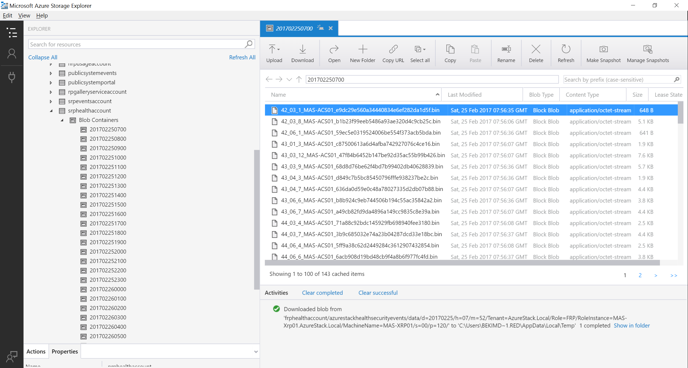

Slide 33
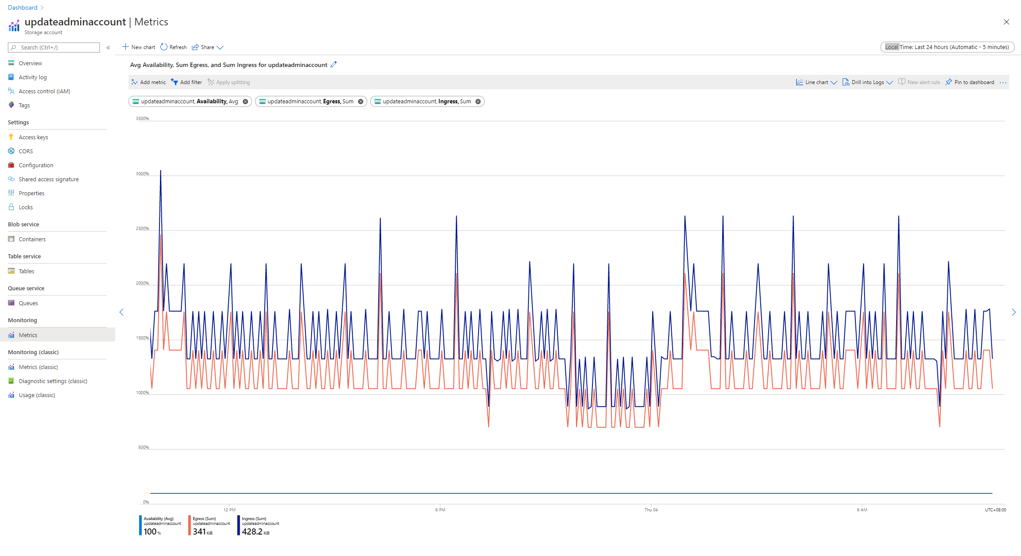

Slide 34
Container Distribution
Account 1
Account 2
Account 3
1
2
3
1
2
3
1
2
3
Storage Services
Volume 1
Volume 2
Volume N
1
2
3
1
3
1
3
2
2
…

Slide 35
Container Overflow
Automatic
Triggered by low share capacity
No interruption to tenant operations
Account 1
2
3
Account 2
Account 3
1
1
2
3
1
2
3
Storage Services
Volume 1
Volume 2
Volume N
2
3
1
3
1
3
1
2
1
!

Slide 36
Tables

Slide 37
Azure Tables
NoSQL key-value store
Flexible schema
Enables rapid development
Scaling from few records to millions of records
Strong consistency model
Table: UserStatus
PK | RK | Name | Status | EmpNo
A | AliceC | Alice Clarke | Available | 1223
PK | RK | Name | Status | WebSite | Email
A | AlexP | Alex Pen | Busy | http://... | alexp@...
PK | RK | Name | Status
B | BobS | Bob Stevens | Offline
Usage examples
Shopping cart
Address book
Device information
Server status
Events & Metrics
PK | RK | Name | Status | Photo | Email
B | BillP | Bill Peters | Available | http://... | alexp@...

Slide 38
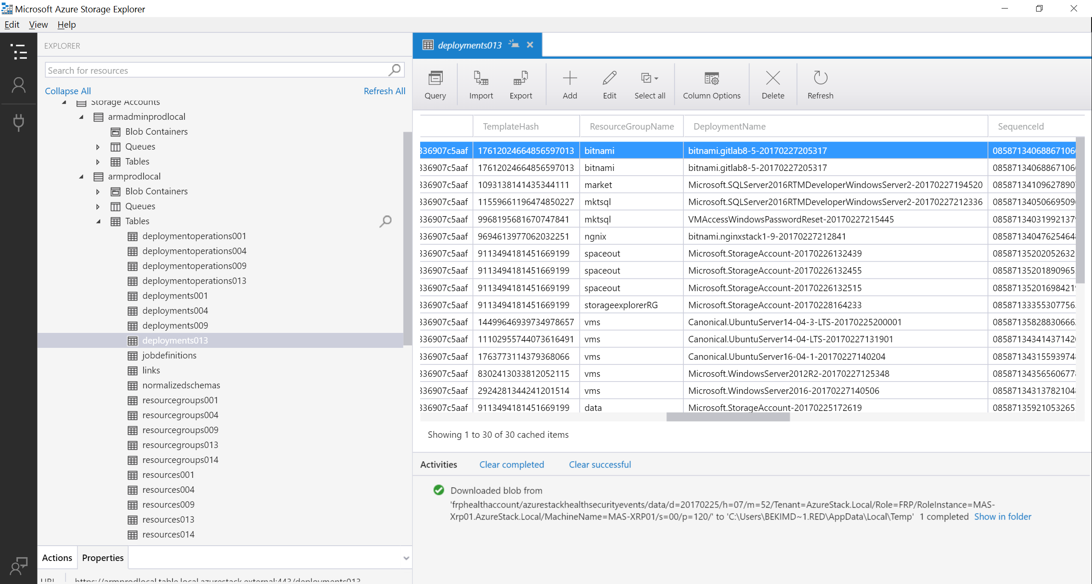

Slide 39
Table storage distribution
Account 1
Account 2
Account 3
Tenant Tables
1
2
3
1
2
3
1
2
3
Storage Services
Table records
Volume 1
Volume 2
Volume N
DB1
DB2
DB3
DB4
DB5
DB6
DB7
DB8
DB9
1
2
3
3
3
1
1
2
2
Database

Slide 40
Limits and constraints
Partition Key and Row Key in the Azure-consistent storage Table implementation are each limited to 400 characters (that is, 800 bytes) in size
All partitions of a tenant table are stored in the same database. This limits the scalability of a single table to the limit of transaction rate of a single table server database

Slide 41
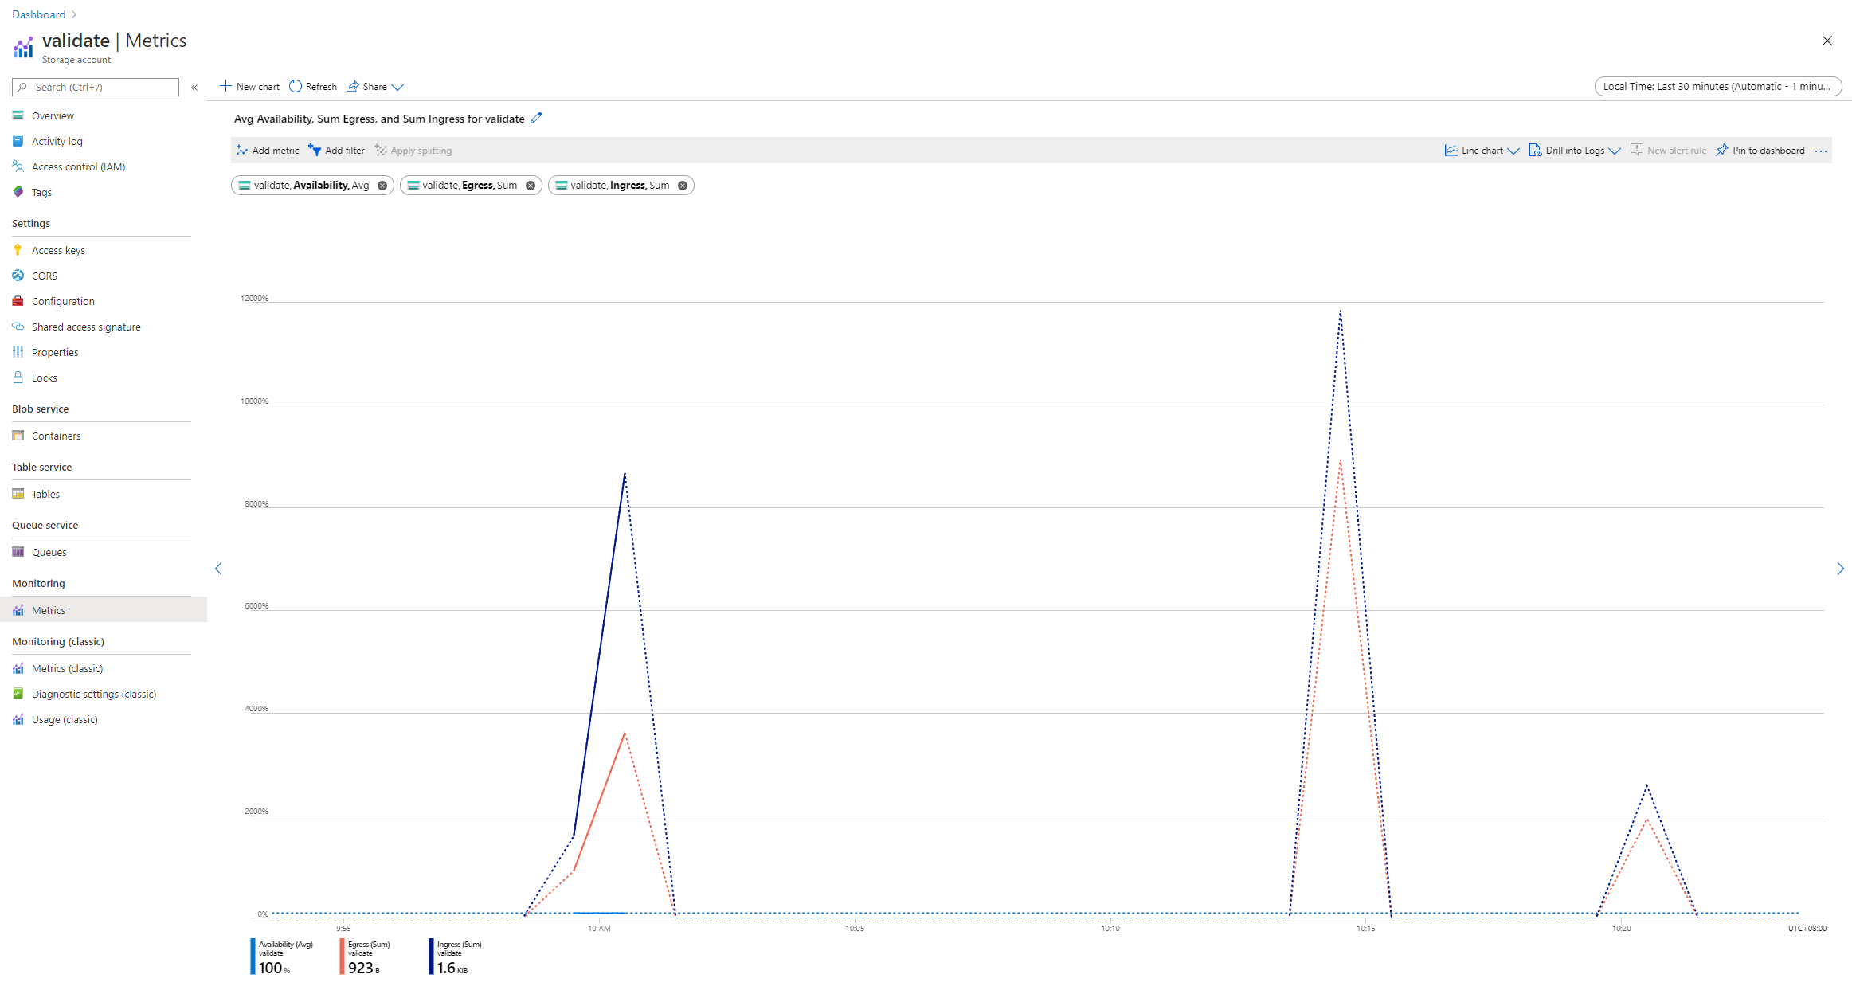

Slide 42
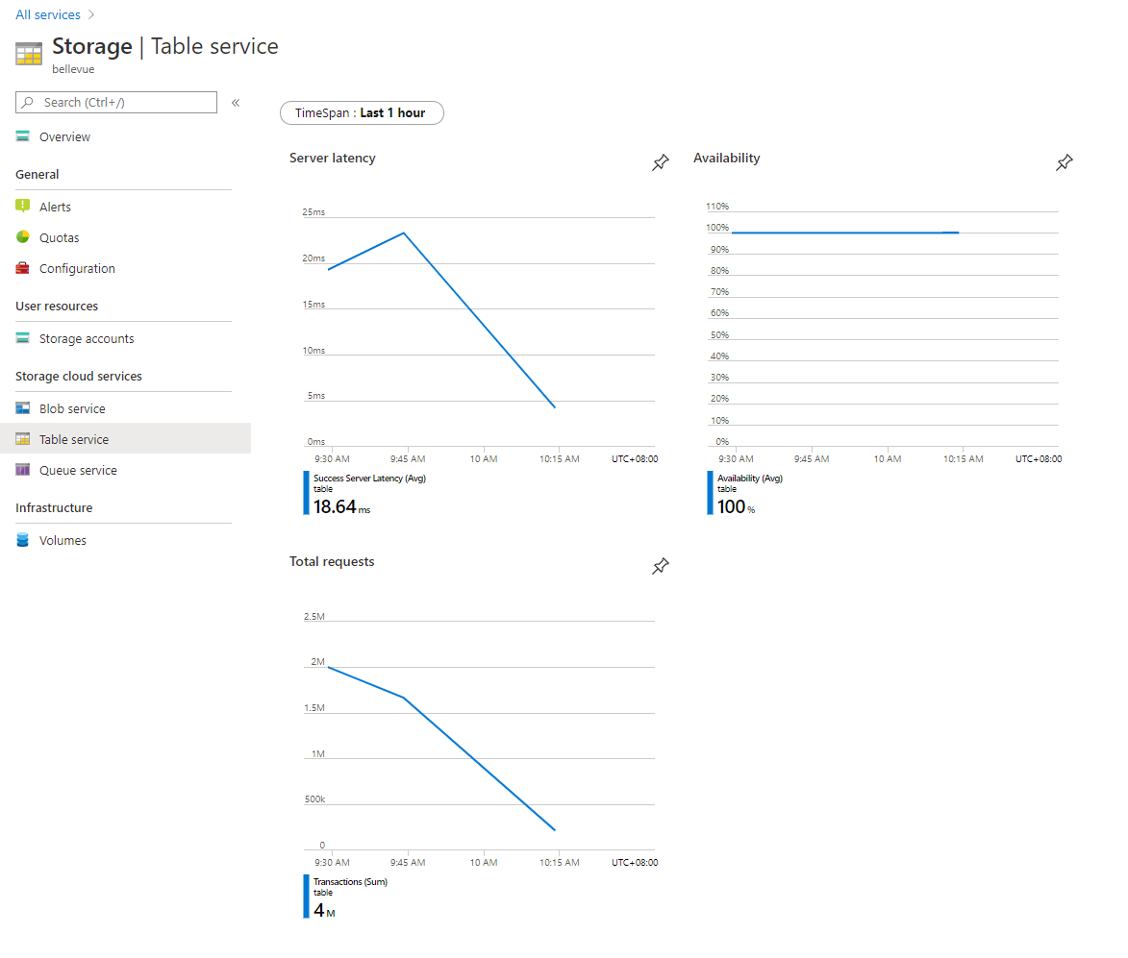
% of billed requests failed due to server error
Average latency of server requests
Total TPS

Slide 43
Queues

Slide 44
Queues
Simple, cost-effective, durable message queuing for large workloads
Accessible from anywhere via authenticated HTTP/HTTPS
Message can be up to 64 KB in size
Queue can contain millions of messages
Usage examples
Asynchronous messaging for decoupled application components
Design resilience to application component failure
Managing a backlog of work items and scaling for burst

Slide 45
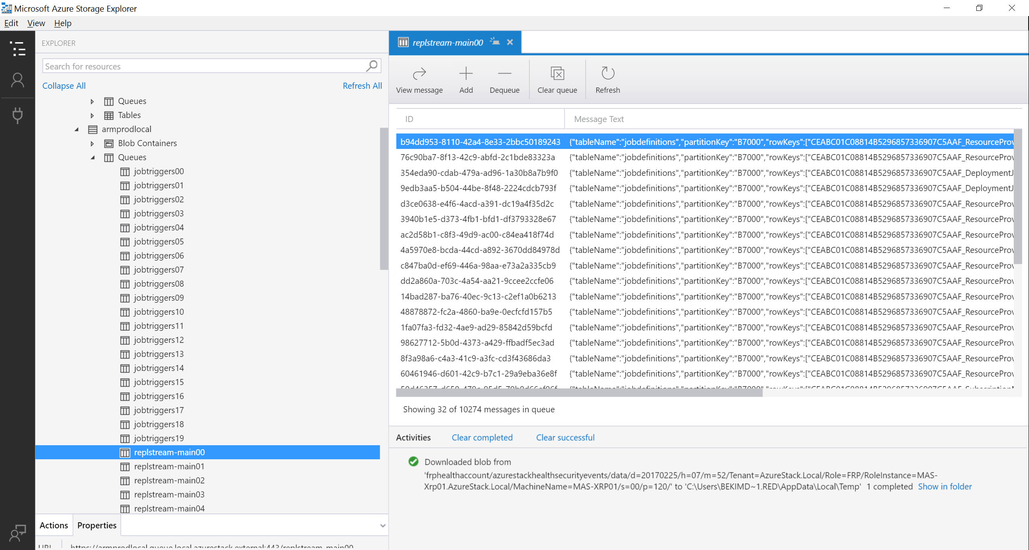

Slide 46
Storage Services Usage

Slide 47
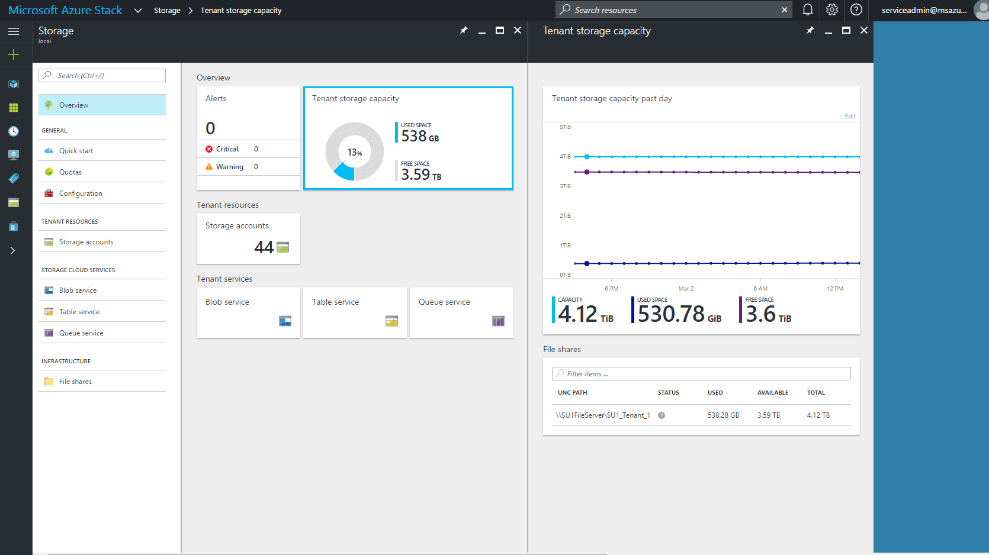
Managing Tenant Storage Capacity

Slide 48
Storage capacity allocation (projected)
System
subscription
Tenant subscriptions
IaaS scenarios
App scenarios
System
Data
Blobs
Tables
Queues
VM
Disks, Images, Snapshots,
Page Blobs
Diagnostics
Blobs & Tables
Blobs
Tables & Queues

Slide 49
Versions
REST API | .NET Client Lib
2019-07-07 | 12.2
2019-02-02 | 11.0
2017-11-09 | 9.2
2015-04-05 | 6.x
2015-07-08 | 7.0
2015-12-11 | 7.1
2016-05-31 | 8.0
Developers can only use supported REST API versions
Must use the corresponding version of client libraries

Slide 50
Storage Container Management

Slide 51
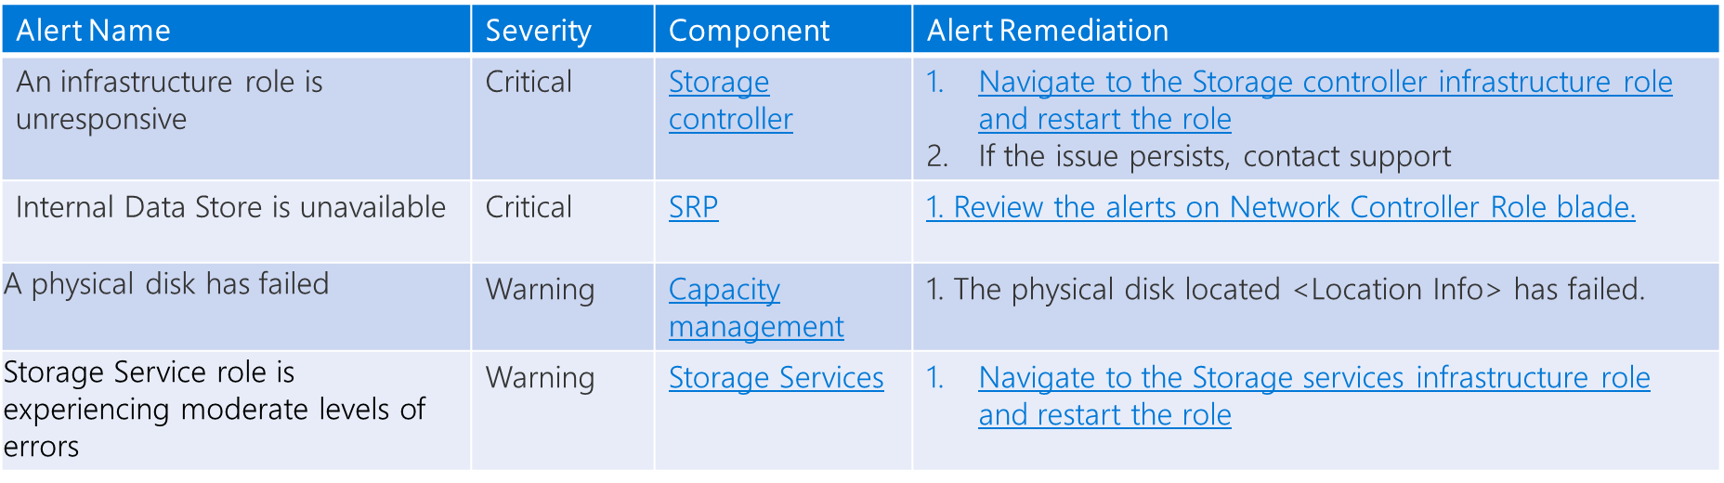
Storage health and monitoring
Capacity view and alerts
Share availability
Share Running out of capacity
Service health alerts
Data store unavailable
Infra dependencies unavailable…

Slide 52
Management considerations
Tenants
Manage Quotas
Add-On Plan to existing offer
Edit Quota object
Administrators
Manage Used Capacity
Reclaim Space (Force GC of deleted storage accounts)
Migrate Disks (move offline managed disk to another volume)
Recover Deleted Account
Retention Period

Slide 53
Management considerations
Reclaim Capacity
You can reclaim the capacity used by tenant accounts that have been deleted. This capacity is automatically reclaimed when the data retention period is reached, or you can act to reclaim it immediately.
Migrate a managed disk between volumes
Due to tenant usage patterns, some tenant shares use more space than others. The result can be a share that runs low on space before other shares that are relatively unused.
Disk migration does not support live migration and currently is an offline operation.

Slide 54
Putting overflow and migration together
Volume rebalance admin alert + action
100%
90%
80%
70%
Container overflow kicks in, less steep slope
New consumption cycle commences…
Volume capacity in use
Steep capacity consumption rate
Disk migration finishes, more available capacity on this volume!
25%
Time

Slide 55
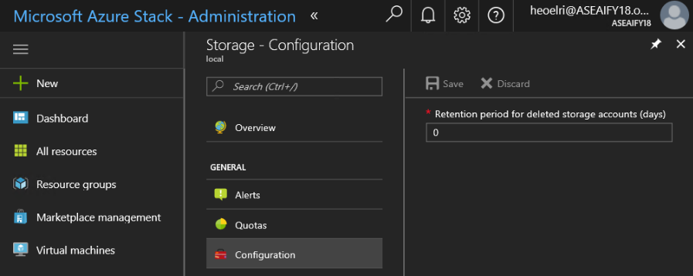
Retention period
“0” means that any deleted account is immediately out of retention
Defined per Region
Defined in days (between 0 and 9999 days)
The default retention period is set to 15 days.

Slide 56
Azure Stack Hub Storage: Recovering a Deleted Blob

Slide 57
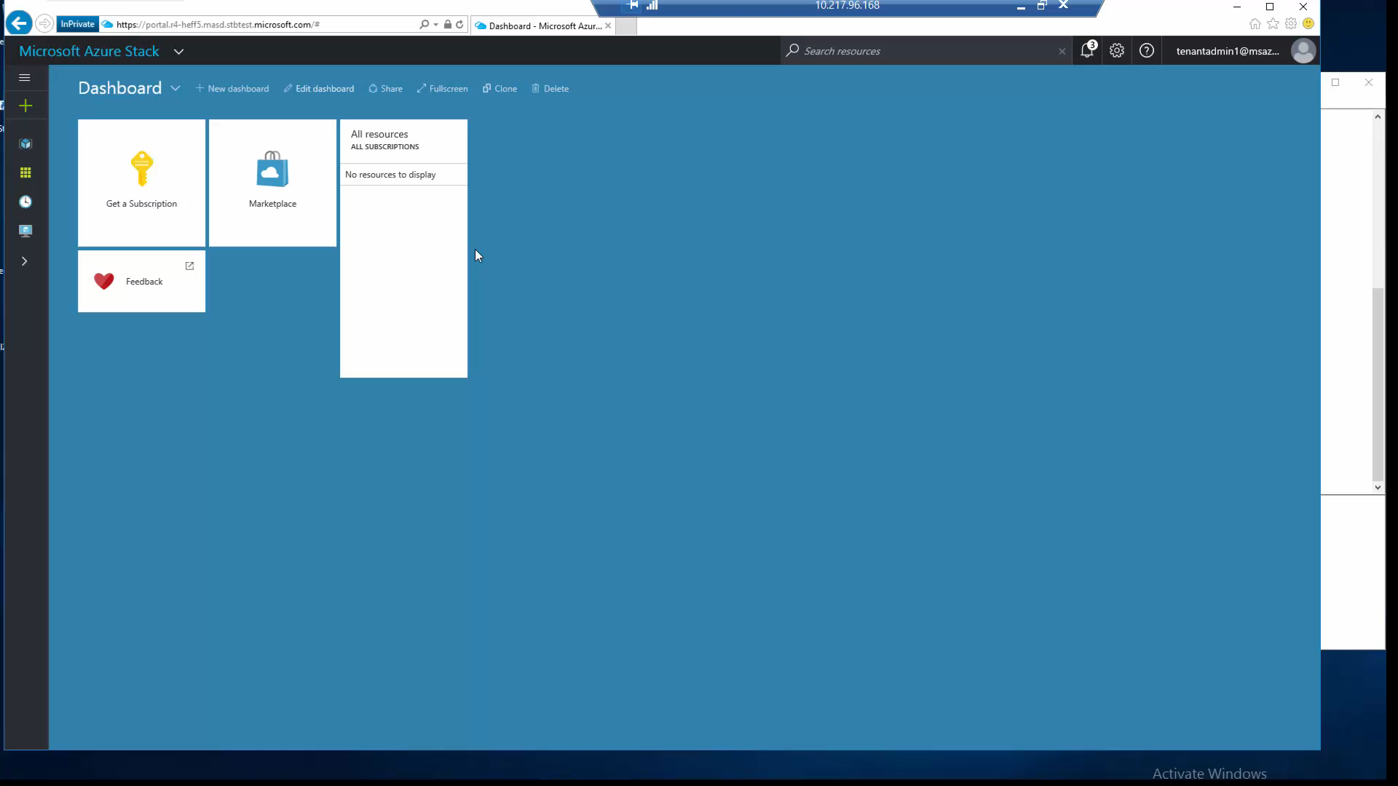

Slide 58
Development Kit Guidance
Azure Stack Hub Development Kit is not for production workloads!
Azure Stack Hub Development Kit is not optimized for performance/scale
But we’d love to hear about your production needs
Single-node hyper-converged SOFS
DAS storage only
Supported API versions
Azure Storage Client Library: Get started with Azure Stack Hub storage development tools
Azure Storage services API: 2017-11-09
Azure Storage services management API: 2017-10-01

Slide 59
Questions?

